Slide 1
Data Analysis on the 2022 Qatar World Cup
Chris Valente, Nikita Gerzhgorin, and Tariq Alagha

Slide 2
Introduction - FIFA & The World Cup
FIFA (International Association Football Federation) is the governing body of the sport of soccer/football worldwide, and is responsible for the growth and maintenance of the sport
The World Cup (hosted by FIFA) is a major international sporting event that is watched by billions every 4 years; the best national teams in world football attempt to qualify to reach the pinnacle of sport competition
This previous 2022 World Cup was the 22nd iteration of the tournament in its history

Slide 3
Introduction - Goal of our Research
By observing data about the matches played in the tournament, the players participating in the matches, and the countries who have teams being represented in the tournament, we hope to be able to visualize the outcome of the tournament in a variety of different aspects.

Slide 4
Research Questions
Who was the most efficient player throughout the tournament, in terms of offensive metrics?
Does the difference in rounds have an effect on the way that teams play? (i.e group stages vs elimination matches)
Having majority possession is considered to be an emphasis in modern football, but did having more possession actually lead to more success?
There was a lot of controversy about this tournament for a variety of reasons; are there any particular trends we can discover about the actual attendance of the matches?

Slide 5
Loading, Cleaning, and Exploring Datasets

Slide 6
Our Datasets
As mentioned previously, we loaded a matches dataset (containing data about individual matches; venue, attendance, the teams playing in each match, and match statistics including goals scored for each team, percentage of possession held by each team, etc.
Our players dataset contained all statistics about the individual player and their performance throughout the tournament (position, country, goals, assists, etc.)
The countries column was a bit trickier, as it was created and not downloaded; all data was scraped and calculated for each country based on the statistics found in the matches dataset

Slide 7
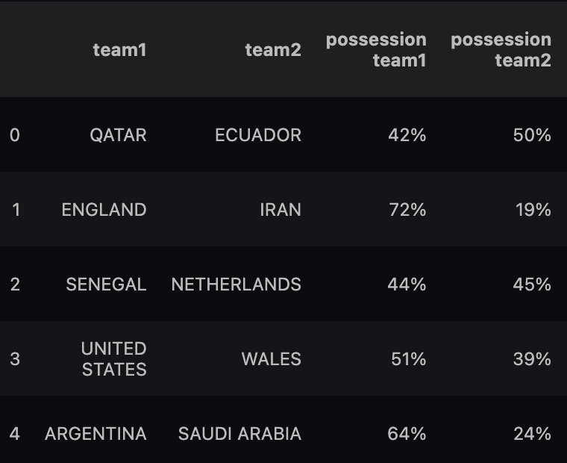
Loading and Cleaning: Matches
Cleaning included converting percentages to int/floats for proper representation (ex. possession shown in the figure), manipulating the formatting of strings, filtering through the columns to keep only what we wanted to work with, and imputing our own columns (ex. adding together the passes that both teams completed to see how many total passes were completed in the match)
Also created a tool that can be accessed here that allows one to view certain statistics for a given match (can revisit this if interested/time remains)

Slide 8
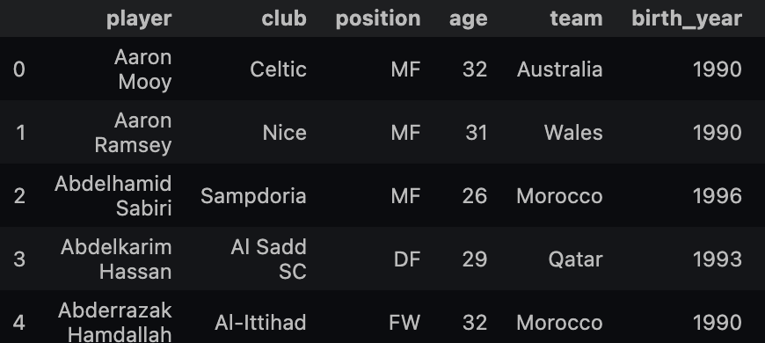
Loading and Cleaning: Players
This dataset was a bit more straightforward to handle; less work had to be done to use it effectively
Only a few columns needed to have their datatypes modified; and only one column ‘G/A’ (will discuss later) had to be imputed

Slide 9
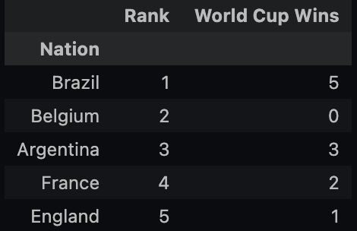
Loading and Cleaning: Countries
This is the dataset that was created based on statistics in the matches column for each country:
Python function that scraped the data for each country by looping through each match and inserting the data into our players dataset
The following figure is our original dataset before modification; we retrieved this information from the FIFA website (rank at the time of the tournament, and total World Cup wins)

Slide 10
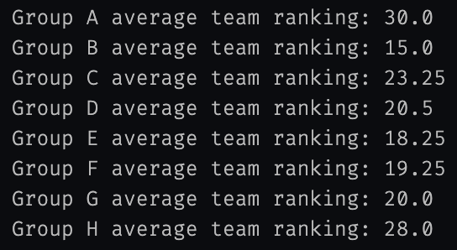
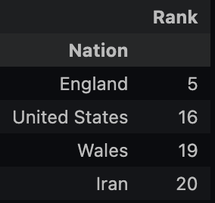
Pre-Analysis on countries: The Group of Death
“Group of Death” - considered to be the most ‘stacked’ grouping of countries that have been drawn to play against each other in the group stage
By filtering our countries together by their Group ID, we were able to ascertain who was in which group, and calculate the average rank of each group

Slide 11
Background Analysis: Visualizing the Countries

Slide 12
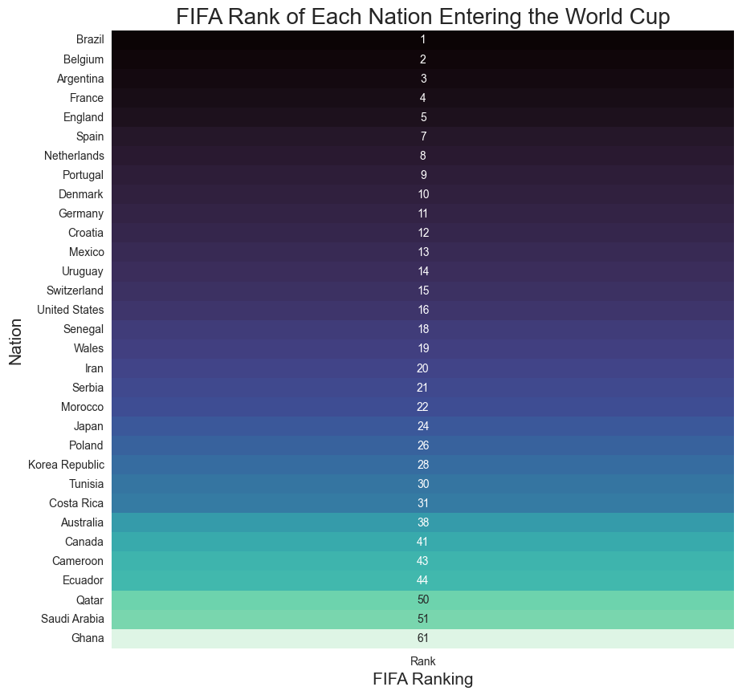
Introducing the Participants
32 countries competing; not the top 32, but the 32 teams that qualified
This explains how we can have:
Rank 1: Brazil
Rank 61: Ghana
* host nation always qualifies on default

Slide 13
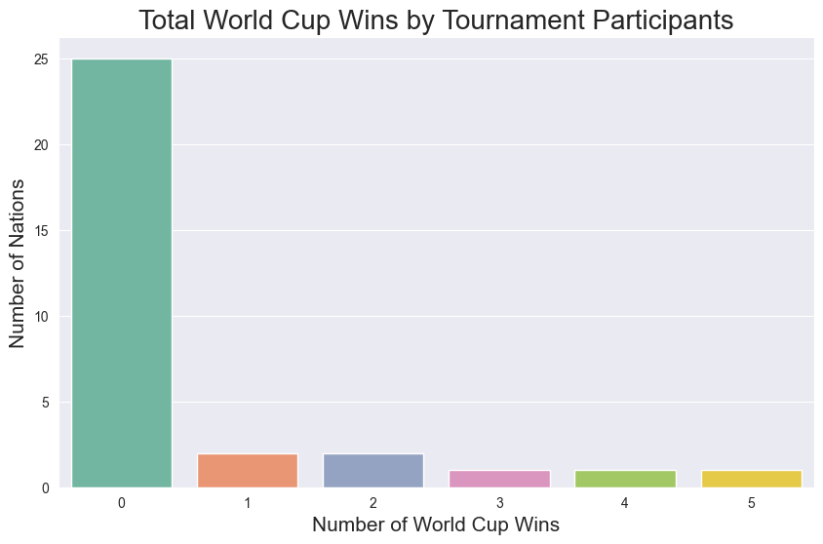
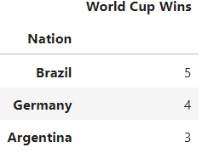
Background into former success
We can see that an overwhelming majority of our participants have never won a World Cup; three total countries participating in this tournament have won more than three (bottom figure)
Interesting note: our participants make up 18 of 22 total World Cup wins; other 4 wins were won by Italy, who lost unexpectedly in a World Cup Qualifying Match

Slide 14
Background Analysis: Visualizing the Players and Performance

Slide 15
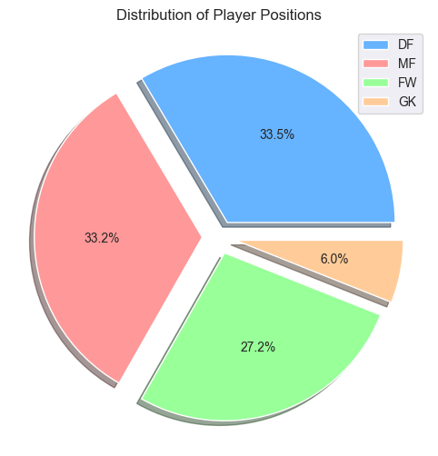
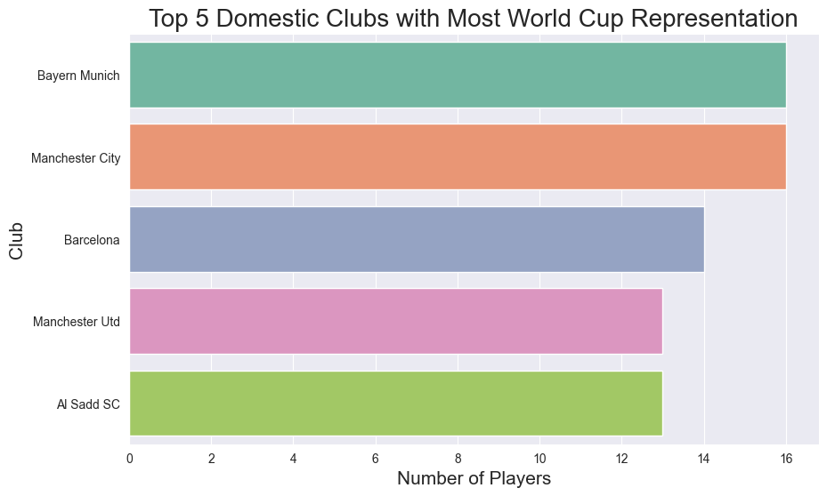
Player distribution of Defenders (DF), Midfielders (MF), Forwards (FW), and Goalkeepers (GK)
Percentage of players like goalkeepers is logically low due to the amount needed on a team; inverse for defenders/midfielders
Lots of well known/successful clubs represented here
Al Sadd SC is an outlier, an interesting one.
It doesn’t fit the mold of the other historic clubs because it is in Qatar (who hosts 2022 game)
Mostly Qatar national team plays for Al Sadd SC.

Slide 16
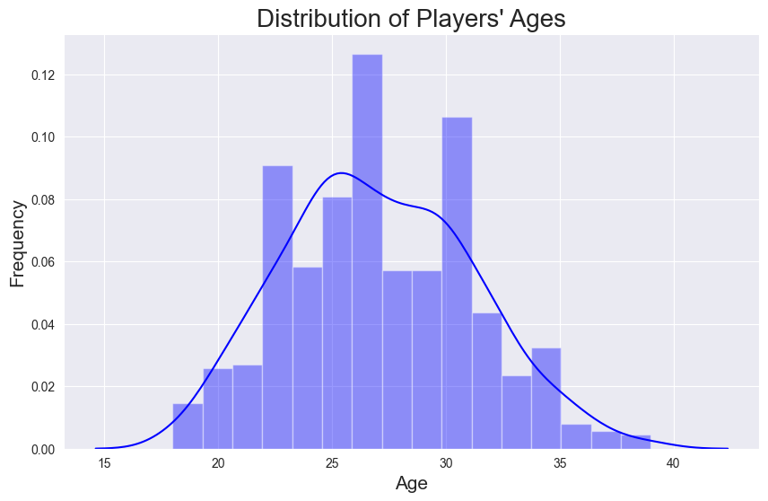
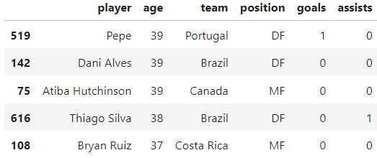
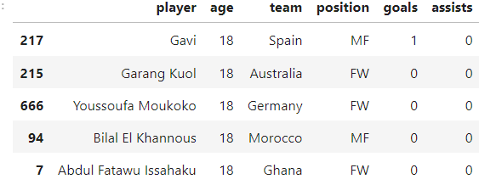
Older:
Younger:
Lots of players in the 27 y/o range.
There’s a spike in the 30 to 32 range.
Also, at the 21 to 23 range.
Makes us wonder who the oldest and youngest in those groups are.

Slide 17
Research Question: Who was the most efficient player throughout the tournament, in terms of offensive metrics?

Slide 18
Advanced Statistics: Guide
We will be exploring some of the advanced statistics provided by our players dataset to see if we can find any trends; first we need to explain what they are
xG (expected goals)- the amount of goals a player is projected to have earned based on shot quality, and other metrics
xA (expected assists) - the amount of assists a player is projected to have earned based on the quality of a pass leading to a shot, among other metrics
SCA (shot creating actions) - a pass, dribble, or drawing of a foul that leads to a goal scoring opportunity
G/A (goals + assists) - the sum of goals and assists a player scored in the tournament (not as advanced as the others)

Slide 19
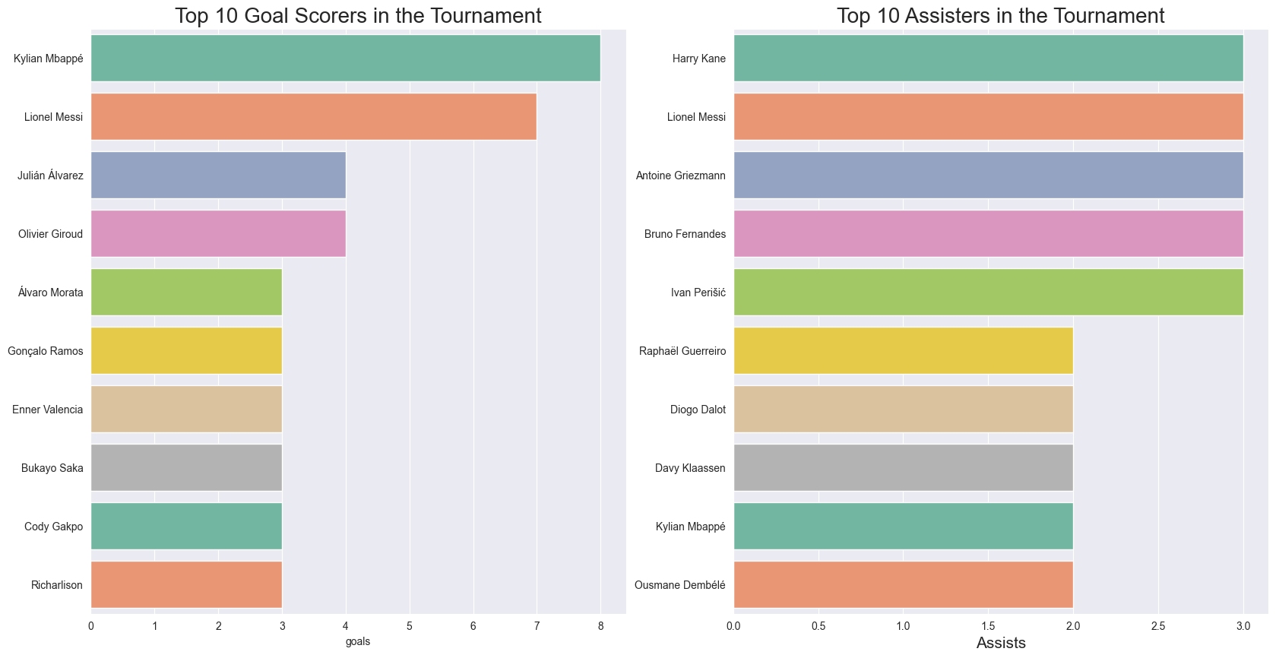
The most obvious metric: Goals and Assists

Slide 20
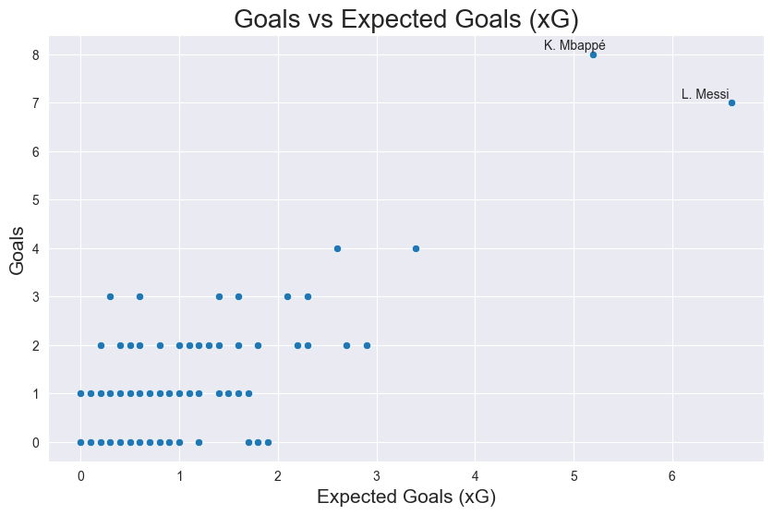
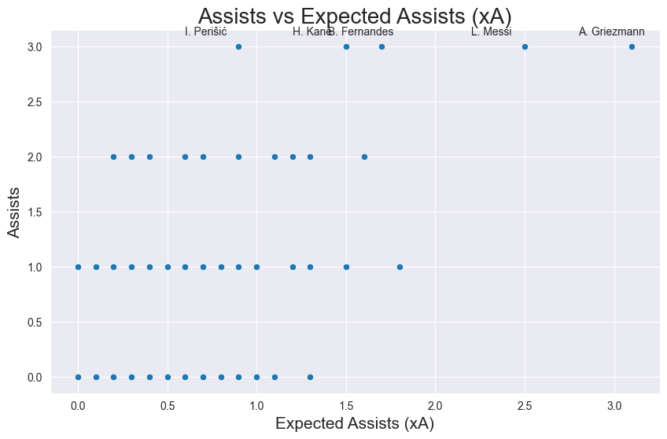
b. xG and xA
K. Mbappe and L. Messi are outliers in the xG chart.
I. Perisic, H. Kane, B. Fernandes, L. Messi, and A. Griezmann are outliers for xA.

Slide 21
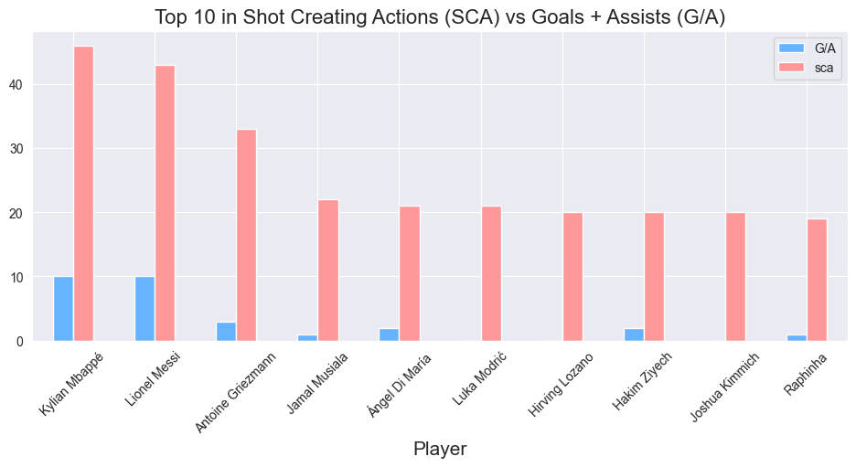
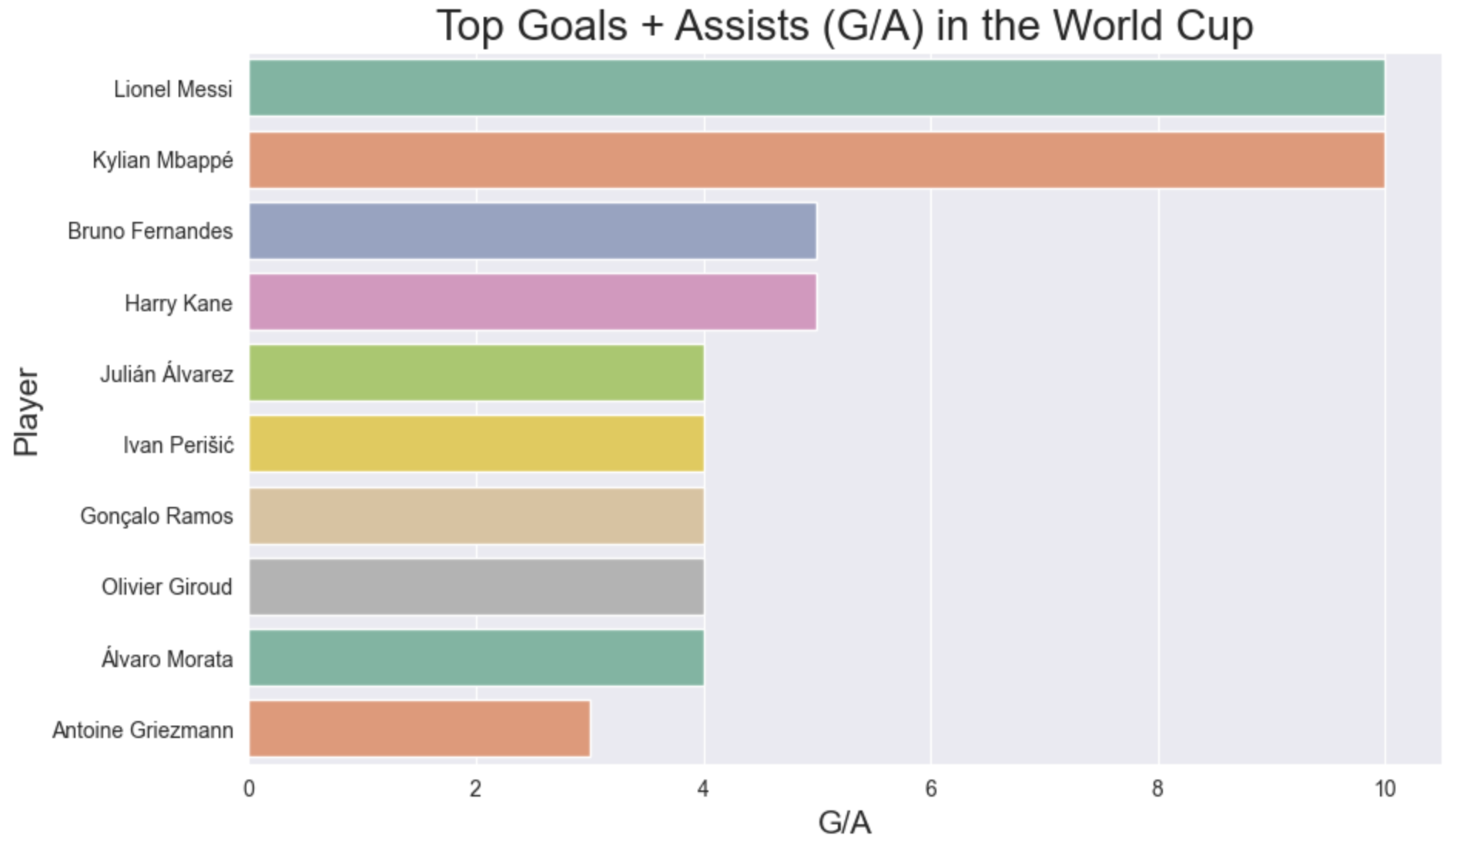
c. G/A and SCA
Correlation exists between SCA and G/A, but not very strong
L. Modric, H. Lozano, and J. Kimmich are new names; 0 G/A combined.
Overall, Messi and Mbappe remain the most productive players.
While SCA is a good indicator of goal scoring opportunities (which in turn leads to goals and/or assists), it is not necessarily a strong indicator of G/A.
We see that Kylian Mbappe and Lionel Messi are tied in contributions with 10 each; next closest is 5, 4, and 3

Slide 22
Research Question: Conclusion
Overall, it is clear that Lionel Messi and Kylian Mbappe have consistently been the most productive players in the tournament. This is not surprising, as they are both world class players, and are both considered to be among the best players in the world. Having produced identical G+A outputs, and leading every advanced statistic together; with Messi showing a slight edge in terms of xG and xA, and Mbappe showing a slight edge in terms of SCA, it is clear that they are two players with different styles of play, but with a similar level of production.

Slide 23
Research Question: Does the difference in rounds have an effect on the way that teams play? (i.e group stages vs elimination matches)

Slide 24
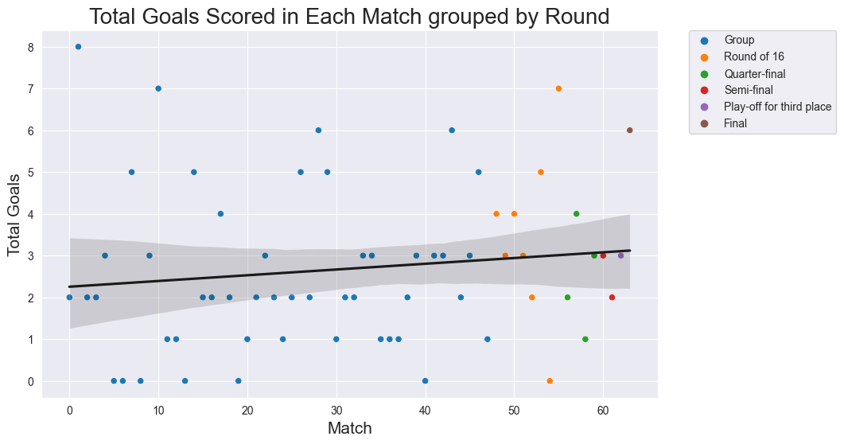
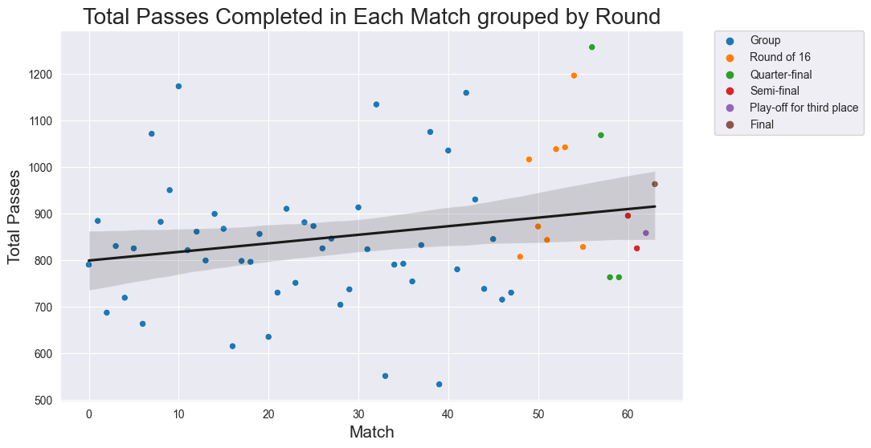
Most matches resulted with under 3 or less goals per game
11 of the 16 knockout matches resulted in 3 or more goals scored.
Teams are more likely to play aggressively in knockout matches.
More at stake.
Majority throughout tournament end up with around 800-900 pass (shown by the trend).
Both teams combined.
Group play matches and elimination matches contain an even split outside of 900 passes.

Slide 25
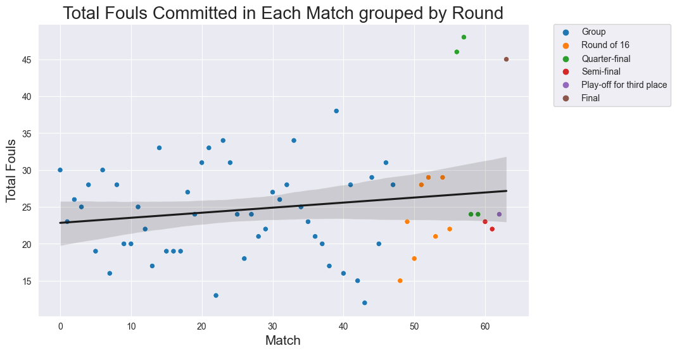
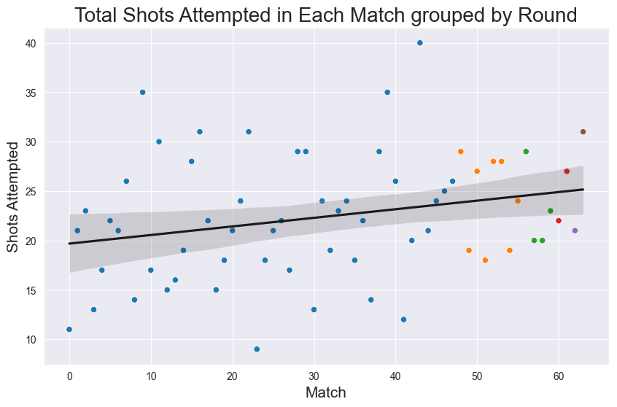
Looking at a tendency: less fouls then mean when occur in knockout matches.
Exception: two quarter final matches and final.
These 2 have outliers of 45+ fouls in 3 matches, mean is a lot more than 24.
Conclusion: There isn’t a substantial change in how teams play in knockout matches.
However, increase in scored goals and decrease in fouls.
Teams potentially adjust their play style in knockout matches, though not a strong enough indicator.

Slide 26
Research Question: Having majority possession is considered to be an emphasis in modern football, but did having more possession actually lead to more success?

Slide 27
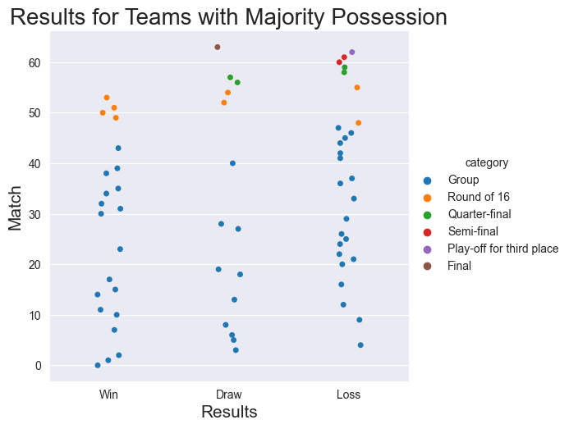
3. Having possession is an emphasis in modern football (soccer), but does having more possession actually lead to more success?
Broken down by round:
More teams lost with majority possession in group play, this can be attributed to the fact that there are more matches in group play
The Round of 16 was the only round where the team with more possession ended up with a positive record
No team with majority possession won in the quarterfinals or in the semifinals
The third place match resulted in a loss for the team that held majority possession
The final resulted in a draw after extra time, and went to penalty kicks

Slide 28
Research Question: There was a lot of controversy about this tournament for a variety of reasons; are there any particular trends we can discover about the actual attendance of the matches?

Slide 29
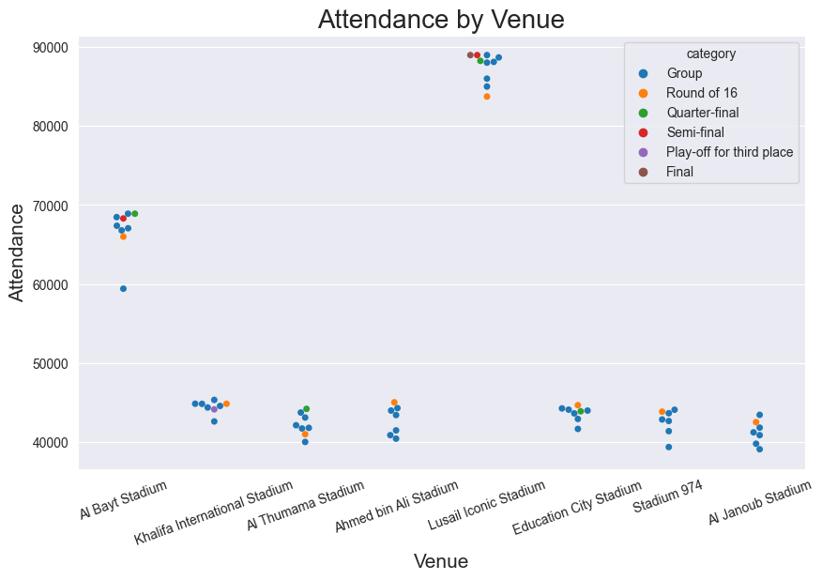
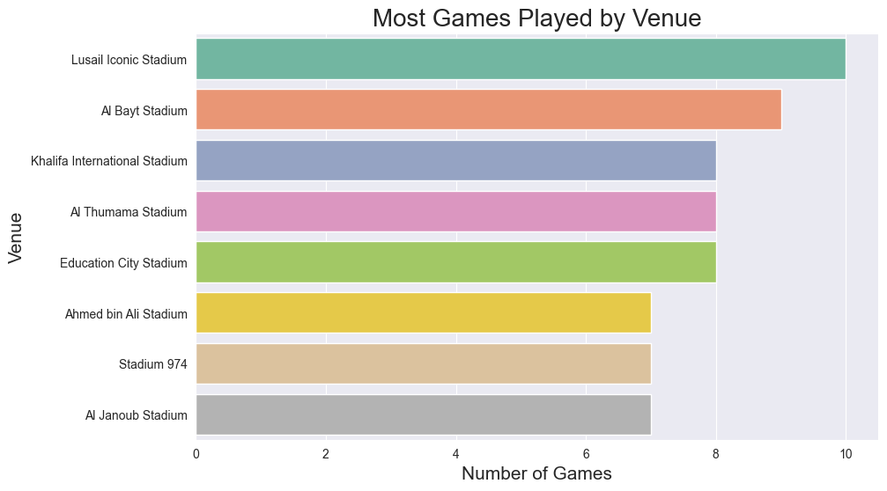
Based on the time of year (midseason instead of in the summer like usual), location for tournament (far from many participating countries, worried about fan attendance), and newsworthy alcohol ban, the attendance was a big question for this particular tournament
We can see that while attendance is in the ~45000 range for majority of stadiums, there are exceptions
Lusail Iconic, Al Bayt - hosts of many elimination matches

Slide 30
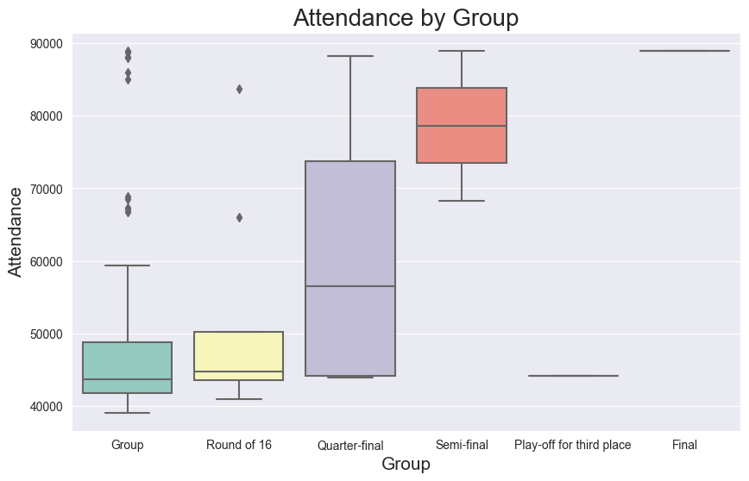
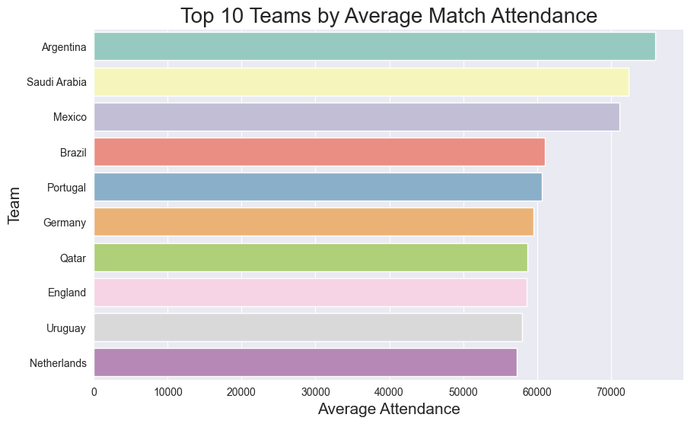
4. (continued)

Slide 31
How does this compare to the previous World Cup?
2022 Qatar World Cup mean attendance through every match: ~53,191
2018 Russia World Cup mean attendance: ~47,371
2022 Qatar World Cup most attended match attendance: 88,966 (multiple times, including the Final; this is assumed to be the capacity of the Lusail Iconic Stadium
2018 Russia World Cup most attended match attendance: 78,011

Slide 32
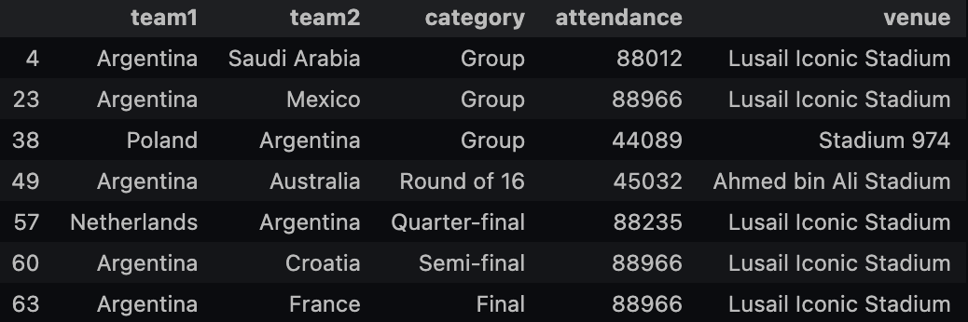
Research Question: Conclusion
We can see that the worries of attendance may have been unwarranted, as average attendance was higher than the previous World Cup, including higher peaks in attendance as well
Argentina matches had higher attendance on average than any other country (one might wonder if the Final played a part in this, but France wasn’t even in the top 10 in terms of attendance)
The Final had the most attendance, but other matches in other rounds got close to a similar attendance level as well
Third-place match was one of the least attended matches out of all

Slide 33
Future Research
Create an algorithm that determines a ‘Starting XI’ of the best players in the tournament; would need access to more statistics that we didn’t have, and more research
Go more in depth on the differences between rounds; we chose to not do this due to fear of repetition (potentially not interesting to continuously observe the same similarities/differences multiple times)

Slide 34
Thank you.

